Slide 1
SMART HOME
AUTOMATION SYSTEM
By,
Vibhay Bakshi 2K22CSUN01157
Garv Sharma 2K22CSUN01138
Mohd Adnan Zohaib 2K22CSUN01149

Slide 2
Contents
01
Introduction
Snapshot on Smart Homes & its benefits.
02
Project Modules
Break down of software and hardware aspect of the smart home automation project
03
Design & Diagrams
Project blue print to ensure installation is carried out in timely and qualitative manner .
04
Components
Components and materials as required to upgrade a normal home to smart home.
05
Software Integration
Final leg of connectivity via Bluetooth & Smart Phones.

Slide 3
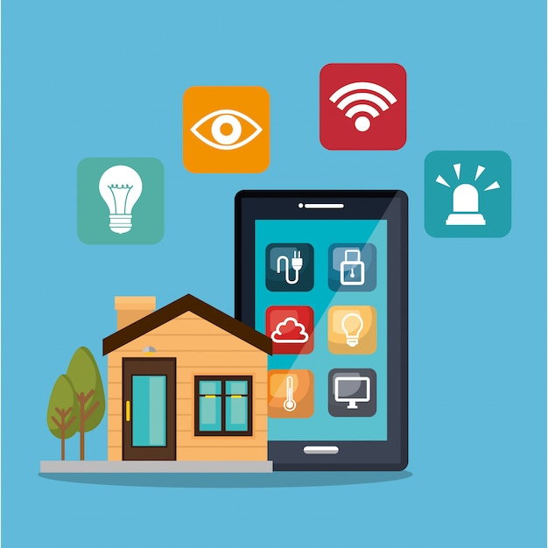
Problem Statement
Optimize energy use while ensuring user comfort in smart homes.
Enhance home security and provide remote monitoring capabilities.
Enable remote control and monitoring of home settings.
Seamlessly integrate with various IoT devices for automation.
Integrate emergency response services for immediate assistance.
Develop a user-friendly interface for easy interaction.

Slide 4
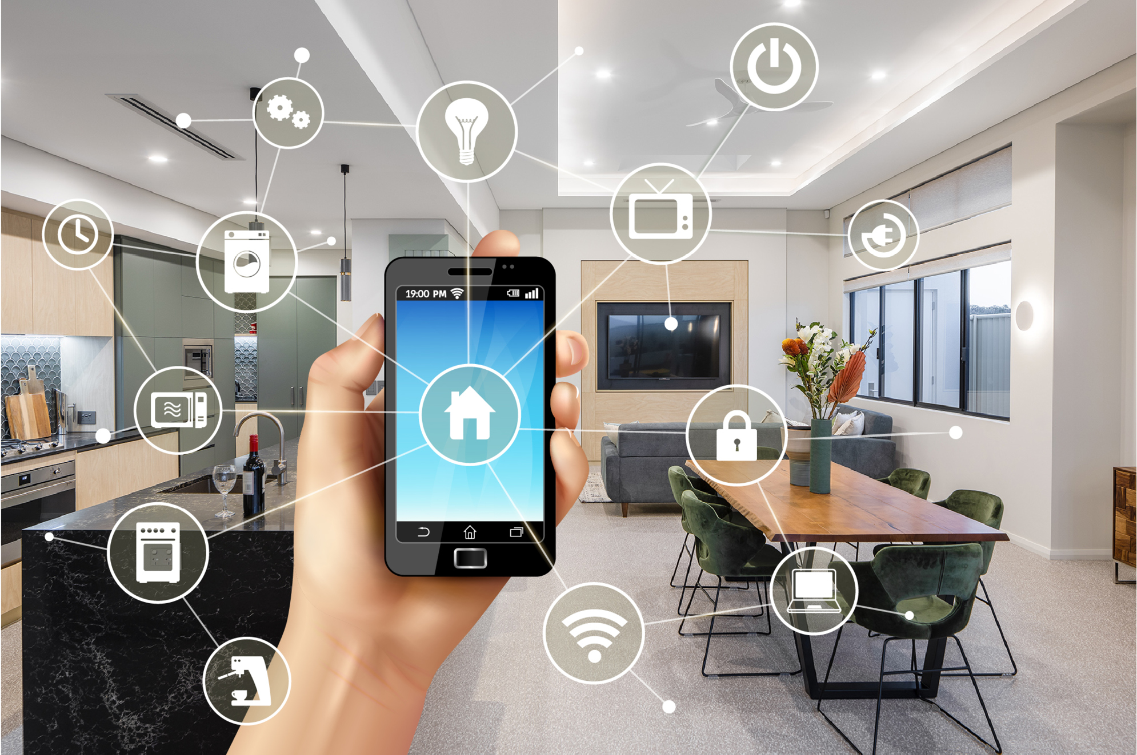
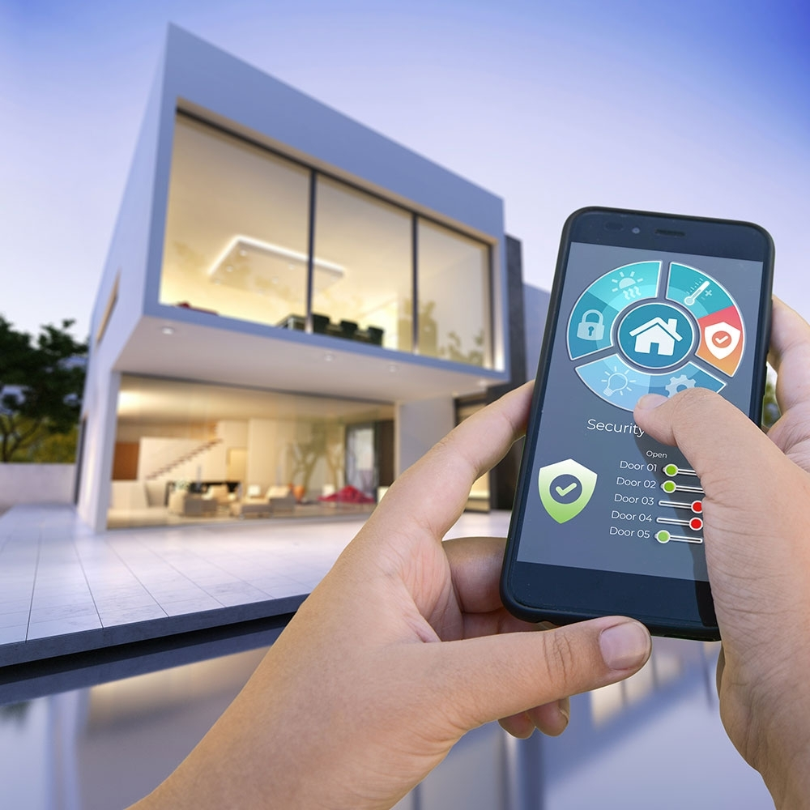
Introduction – SMART HOMES
Smart home as home automation provides homeowners the added Security, Comfort, and Convenient System in their hands by allowing them to control smart devices, often by a smart home app on their smartphone or other networked devices for
Fire, Gas & Door Control and Alarm Systems
Electrical Utilization
Heat & Cooling System Management
Appliances Management
The Person using their smartphone can control their house from anywhere
The Smart Home technology also enables them to automate the entire system via time management to check and control its utilization thus saving energy and money.

Slide 5
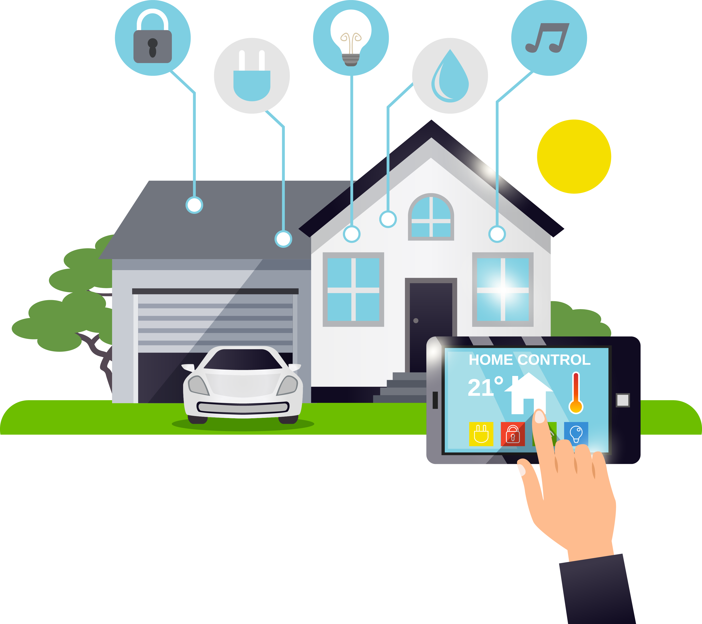



About Home Automation
Technology
Ensuring with certain degree of computerization and installation of few gadgets one can better control their electrical and electronics appliances installed at their home.
Better Control
How it Works
Hand-held Devices
Target is to provide control to the owner to manage the home from home or remotely
The project showcase the home appliances & its communication with Mobile host controller
Smart phones, tab & other Bluetooth enabled devices can be used to control & communicate

Slide 6



Sustainable Development Goals (SDGs)
Optimizing energy consumption to contribute to sustainable development.
Incorporating novel ideas and innovative solutions to address modern challenges.
Enhancing safety and security measures in urban living environments.

Slide 7
Project Modules
Smart Home
Automation Project
Hardware
Software
Microcontroller
Circuits, Relays , ICS & wires
Bluetooth Component
Android

Slide 8
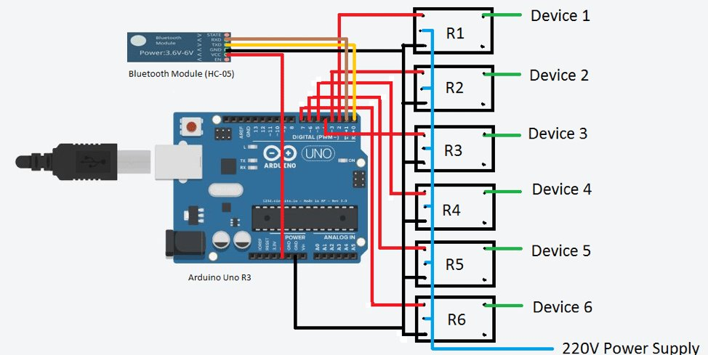
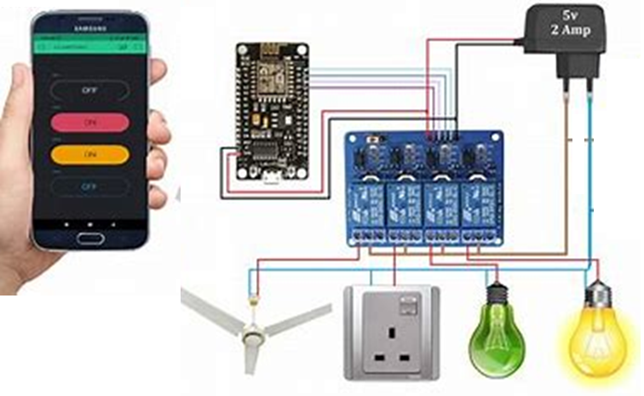
Project Block Diagram
Sample Demo

Slide 9
Software Integration
With the help of Android Phone’s Application that can control various appliances one can connect them and control the same as per need felt
Conclusion:
Android use is more friendly and user interface is easily understandable
Uses of remote control can be avoided
Home automation or smart home systems create safer, more comfortable living spaces with all of the conveniences that we've come to expect.

Slide 10
Project Plan
Problem
Ideation
Research and
Planning
Materials Collection
Development
Integration & Testing

Slide 11

By this, we end our presentation
Our smart home automation system offers a holistic solution to address efficiency, reliability, and security concerns while promoting energy sustainability and innovation in modern living environments
References: https://nevonprojects.com/home-automation-using-android/ https://youtu.be/xz2jNGAl8_I?si=r_muLxEF-ebwhcHE https://youtu.be/_eFW_4HKhys?si=bSz3BFI6-SckQz00 https://youtu.be/_eFW_4HKhys?si=_UDeYlVPgnqOr-Ap https://youtu.be/pfc1IoTOn8s?si=Q_HE-ptppZnahPTZ

